Slide 1
Latin Roots: spect / tract to look or watch / to drag or pull
Vocabulary Construction – Unit 17
by Marcia Timmel Art by Phillip Martin

Slide 2
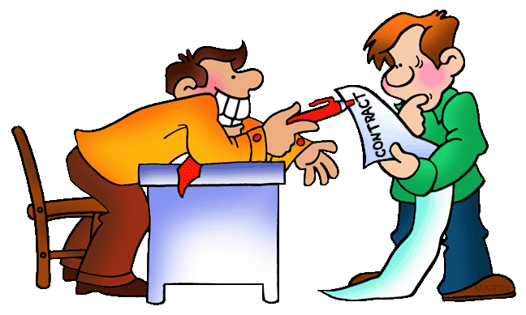
1. contract
1. (v) agree to do something;
(n) a formal agreement

Slide 3
2. introspective
2.(adj) examining your own feelings

Slide 4
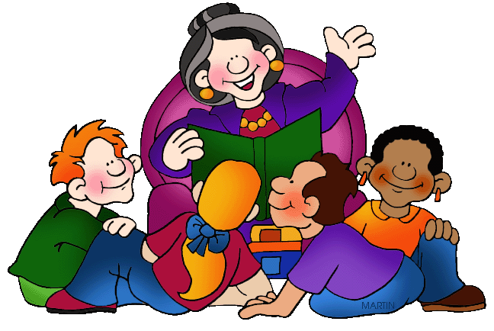
3. spectator
3. (n) somebody who watches

Slide 5
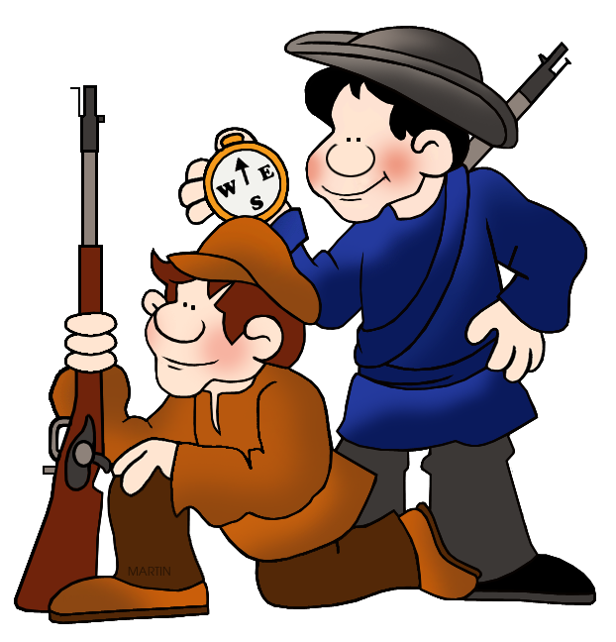
4. circumspect
4. (adj) considering all consequences before acting

Slide 6
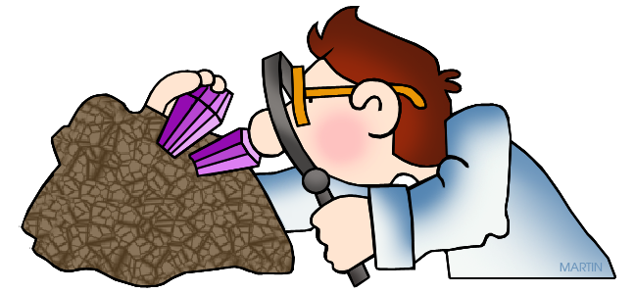
5. inspector
5. (n) an official examiner

Slide 7
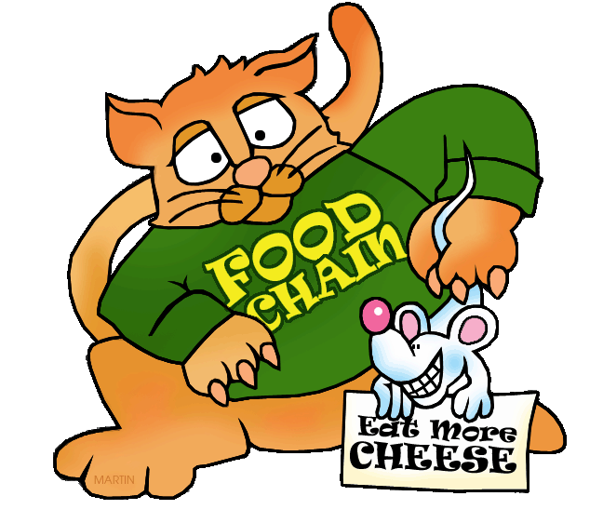
6. retract
6. (v) to take something back

Slide 8
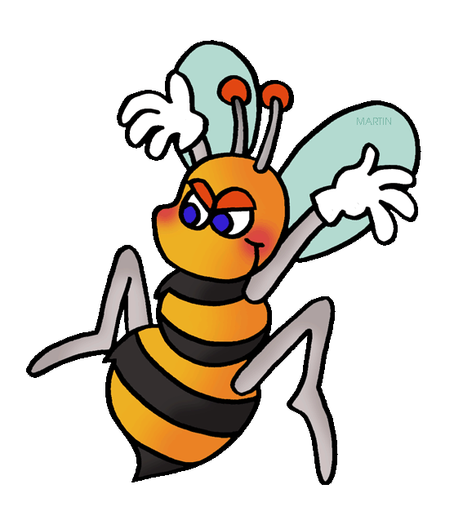
7. attract
7. (v) to draw somebody’s attention; appeal to people

Slide 9
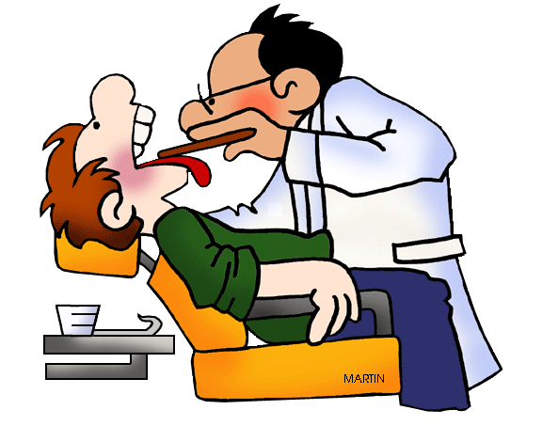
8. extract
8. (v) to pull something out; (n) a passage from a text

Slide 10
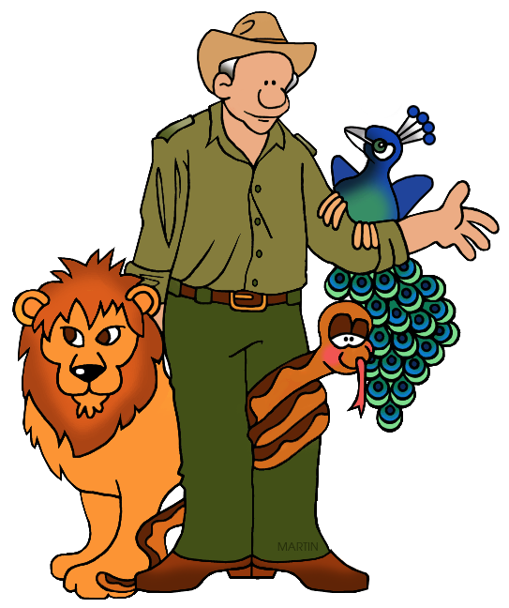
9. tractable
9. (adj) easy to control or persuade

Slide 11
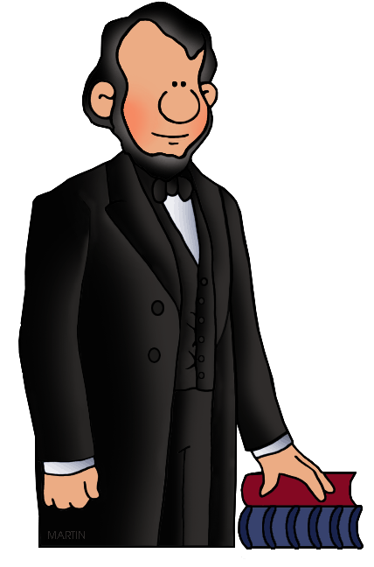
10. respectable
10. (adj) morally above criticism

