Slide 1
Latin Roots: Ject / Struct to throw or put / to build or assemble
Vocabulary Construction – Unit 16
by Marcia Timmel Art by Phillip Martin

Slide 2
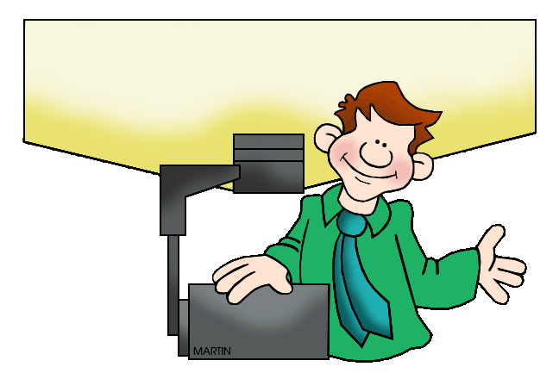
1. projector
1. (n) equipment for putting images on a screen

Slide 3
2. interject
(v) to interrupt with a comment

Slide 4
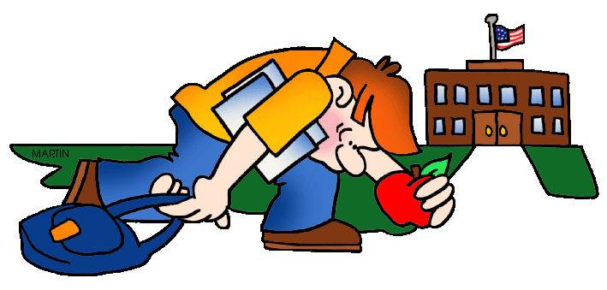
3. dejected
3. (adj) very unhappy

Slide 5
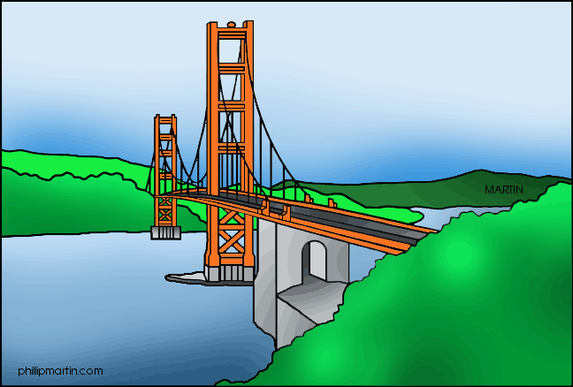
4. structure
4. (n) something built or assembled

Slide 6
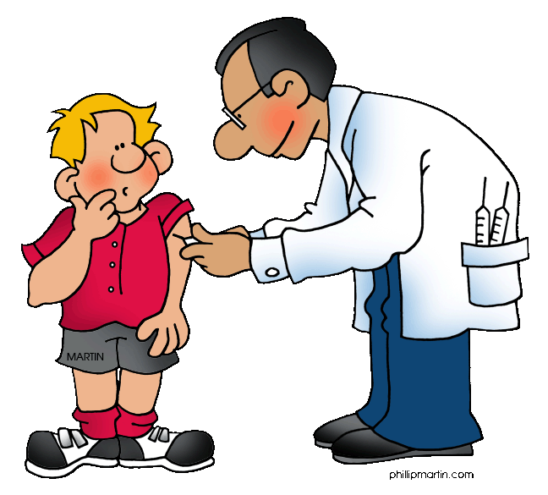
5. injection
5. (n) a dose of drug put in the body with a syringe; adding something

Slide 7
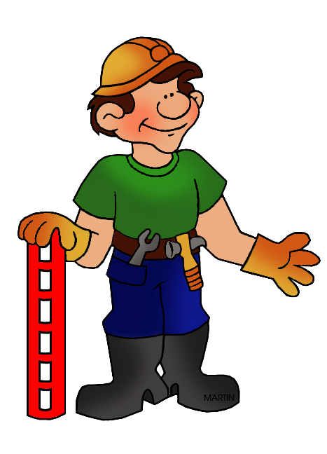
6. construct
6. (v) to build or create something.

Slide 8
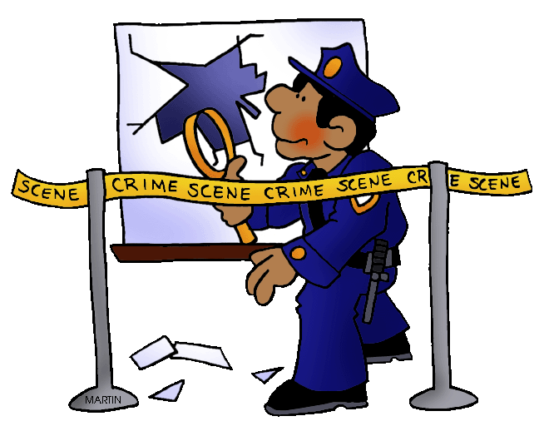
7. obstruct
7. (v) to block something; to slow down

Slide 9
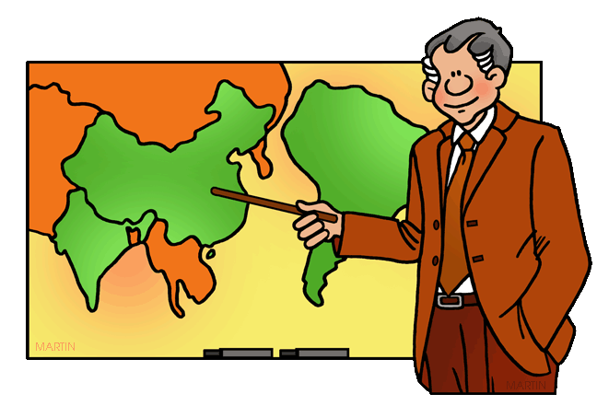
8. instruct
8. (v) to train or direct someone

Slide 10
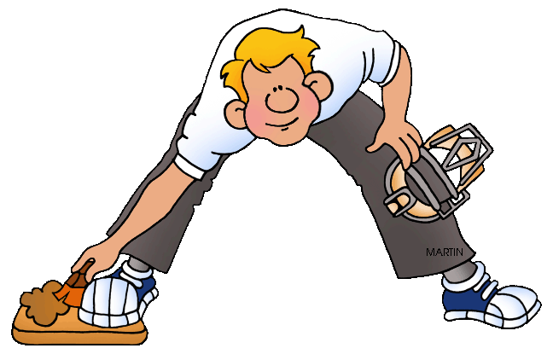
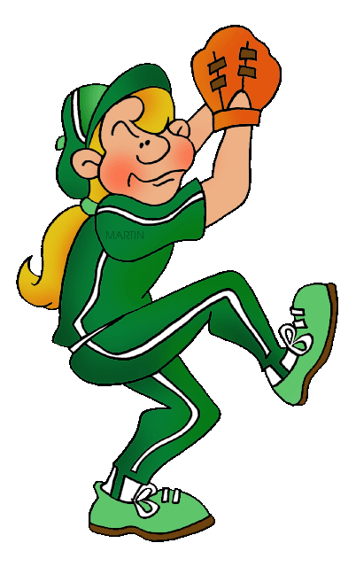
9. eject
9. (v) to push something out with force

Slide 11
10. destructive
10. (adj) meant to damage or hurt

