Slide 1
Latin Roots: Dict / miss to say or tell / to send
Vocabulary Construction – Unit 15
by Marcia Timmel Art by Phillip Martin

Slide 2
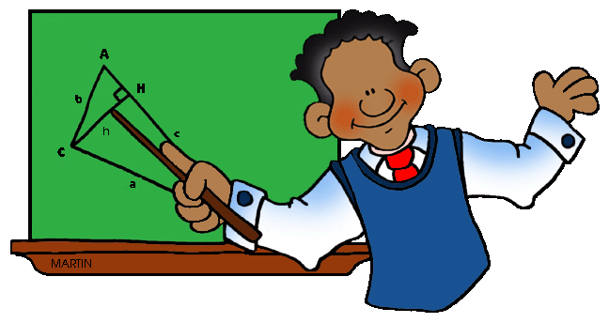
1. indicate
1. (v) to point to something; to show what someone thinks or intends

Slide 3
2. dismiss
(v) to refuse to consider something; to end an activity for someone

Slide 4
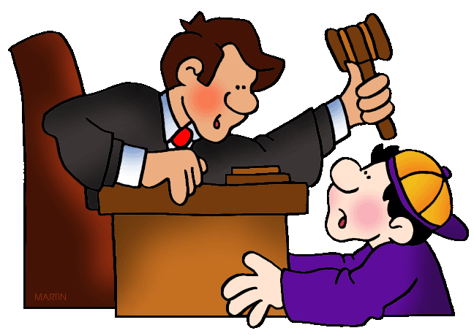
3. contradict
3. (v) to disagree with; to show to be wrong

Slide 5
4. mission
4. (n) an assigned task; a person’s calling

Slide 6
5. emit
5. (v) to send or give out something; to make a sound

Slide 7
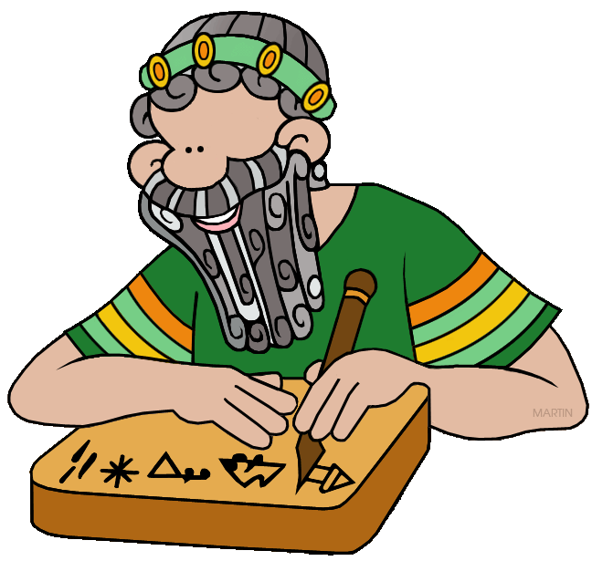
6. dictate
6. (v) to rule or control other people; (n) a governing principal or command.

Slide 8
7. transmit
7. (v) to send something; to communicate information or a signal

Slide 9
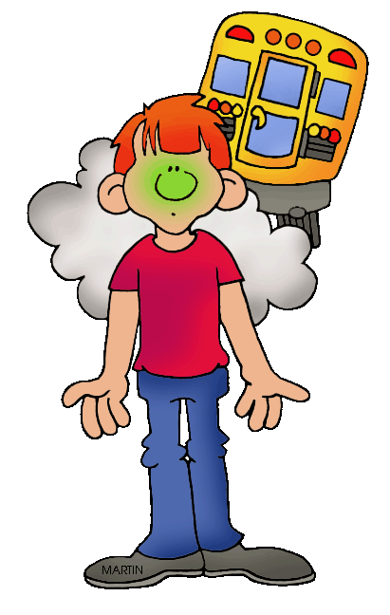
8. emission
8. (n) something that is produced or given out

Slide 10
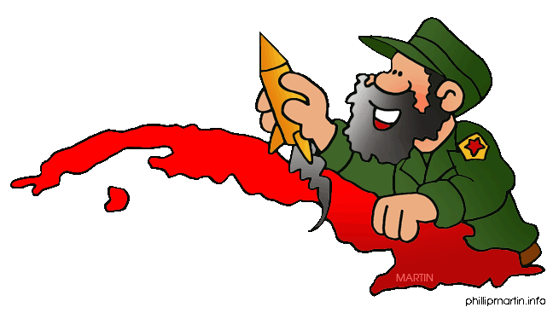
9. dictator
9. (n) a powerful, controlling person

Slide 11
10. predict
10. (v) to say what will happen

